Slide 2
Conclusion
Clemens Schotte & Jesse van Leth
Technical Evangelist

Slide 3
What we covered

Slide 4
Microsoft Edge
Innovation of the web
Azure
.NET Core
ASP.NET Core
Modern front-end tooling
Visual Studio 2015 & Code

Slide 5



ASP.NET 4.6 and ASP.NET Core 1.0
ASP.NET 4.6
ASP.NET Core 1.0
.NET Framework 4.6
.NET Core 1.0
.NET framework libraries
.NET core libraries
Compilers and runtime components (.NET Compiler Platform: Roslyn, C#, VB, F# Languages, RyuJIT, SIMD)

Slide 6
Top resources for more info

Slide 7
ASP.NET Questions
http://www.asp.net/feedback
Twitter - @aspnet
Facebook - /ASPNET
G+ - ASP.NET

Slide 8
Web Camps
http://www.devcamps.ms

Slide 9
Microsoft Azure
http://azure.microsoft.com

Slide 10
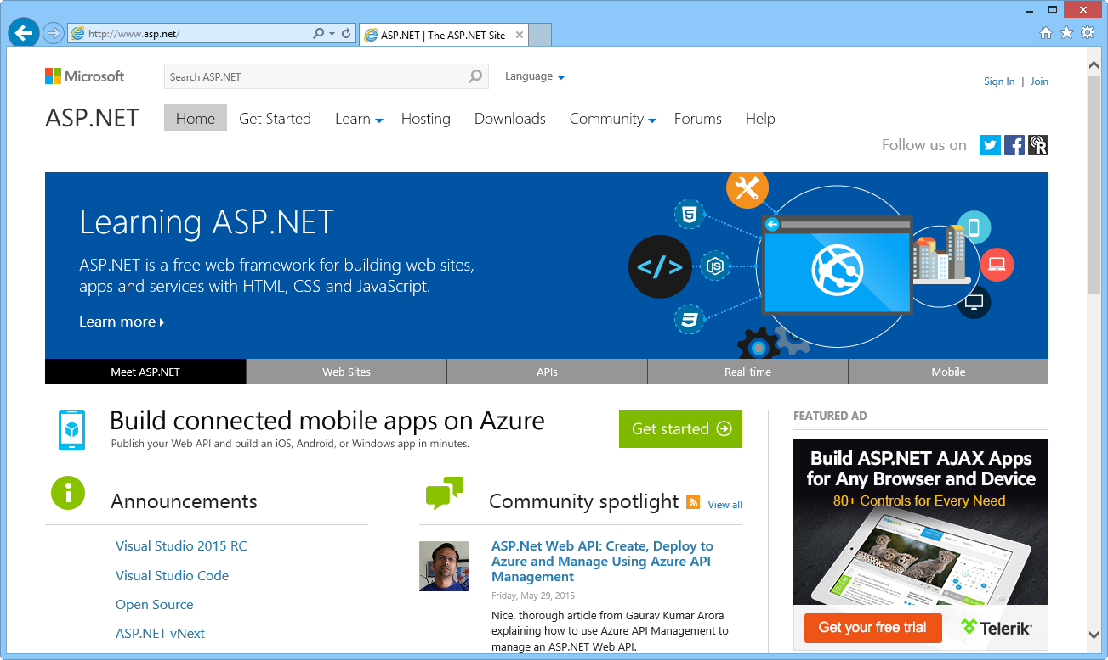
ASP.NET site

Slide 11
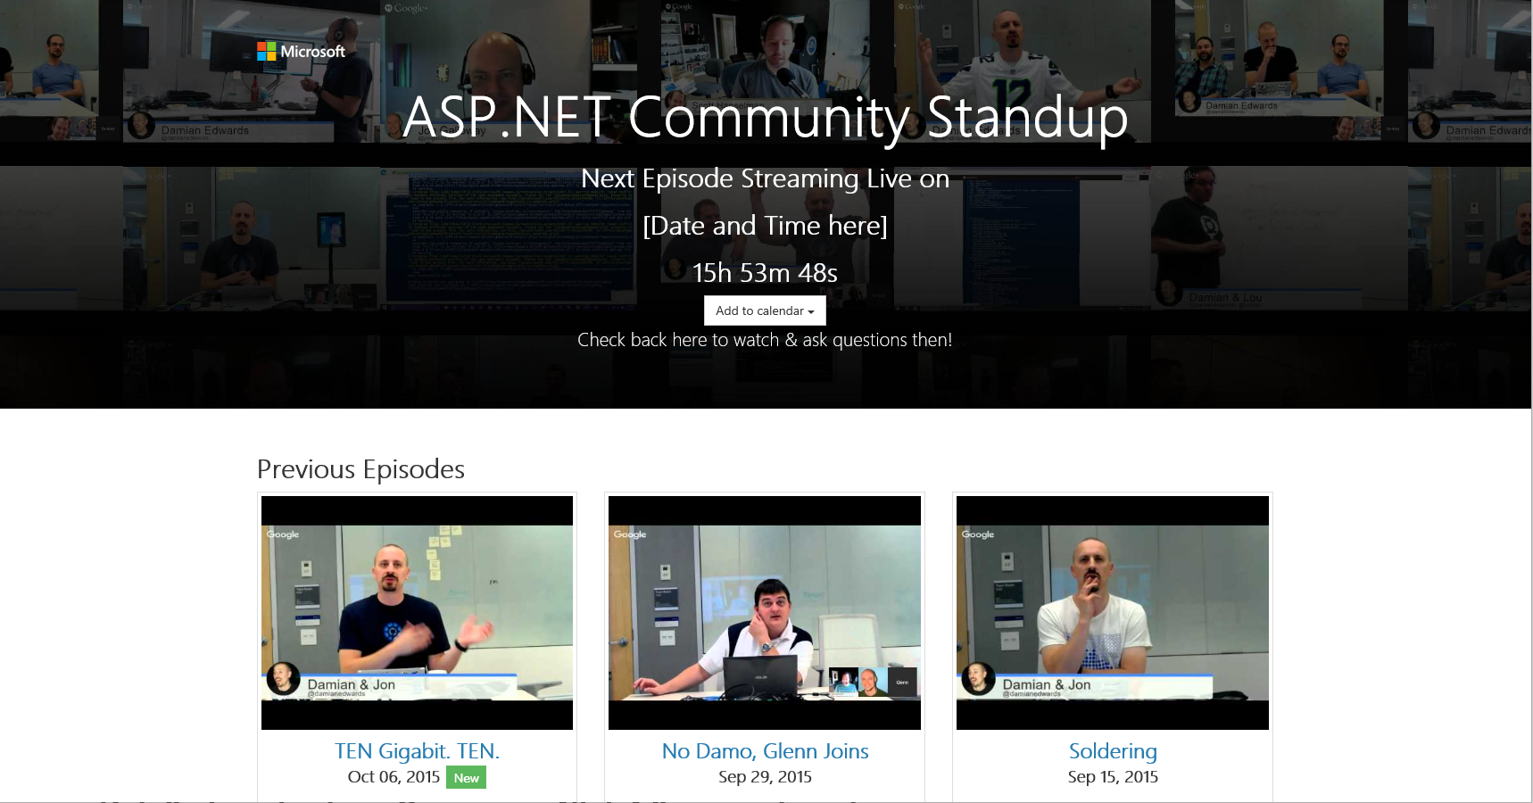
http://live.asp.net

Slide 12
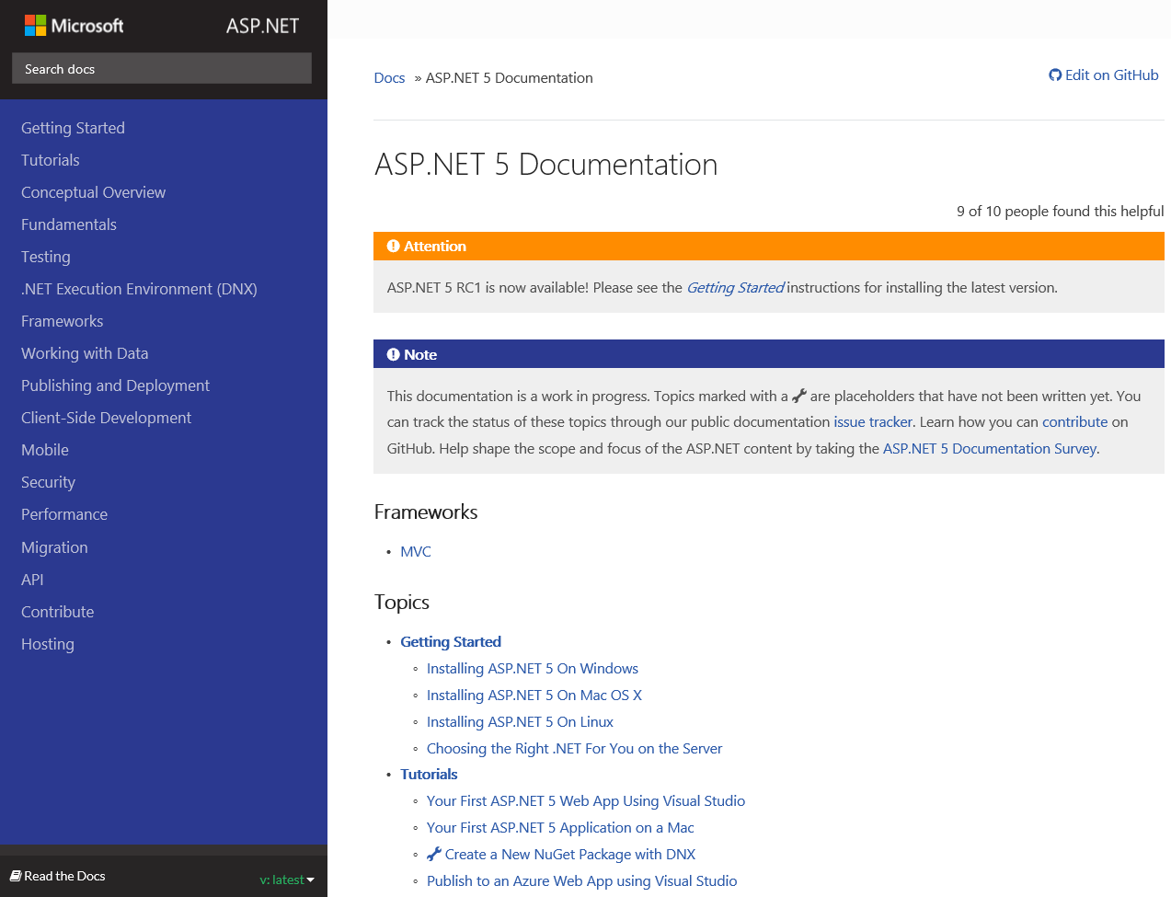
http://docs.asp.net

Slide 13
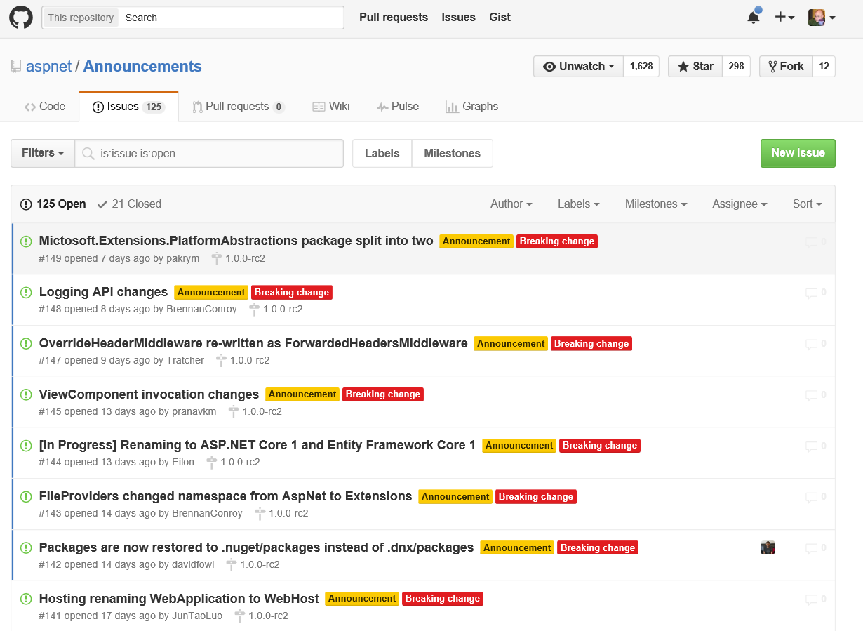
https://github.com/aspnet/announcements/issues

Slide 14
https://github.com/DXNL/accelerate
Presentations & HOL

Slide 15


